Slide 1
Intuilize – Cluster Commanders Customer Segmentation & Prediction Weekly Meeting 1/31/2025
Andy, Graham, Keertana, & Shashank

Slide 2
Agenda
Requirements Analysis Document
Environment Setup
Started Data Analysis

Slide 3
Requirements Analysis Document
RAD is completed
Team will iterate based on feedback

Slide 4




Environment Setup
Team has created environment
Will start working with the dataset next week

Slide 5
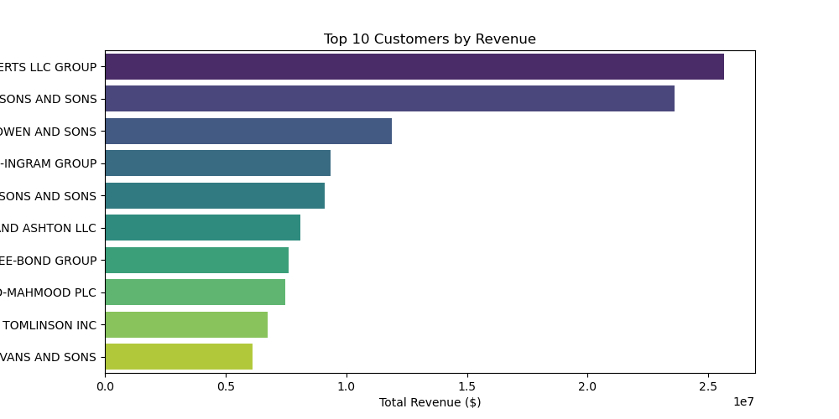
Started Data Analysis

Slide 6
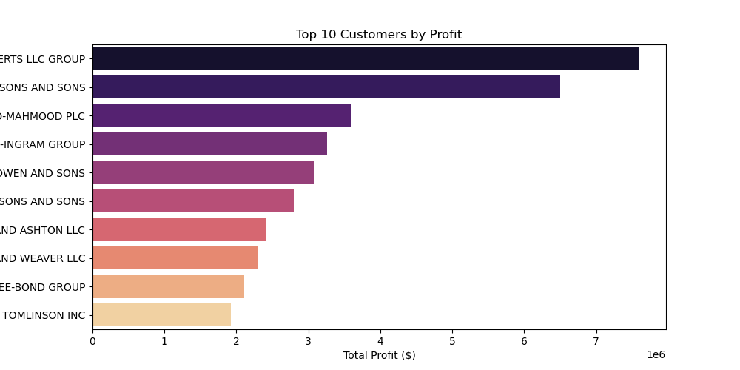

Slide 7
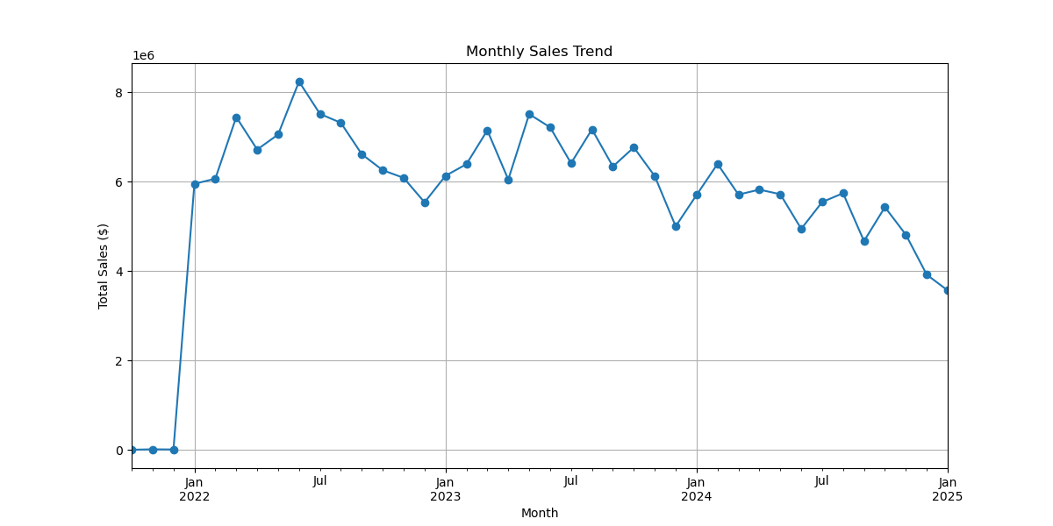

Slide 8
THANK YOU!

